Slide 1
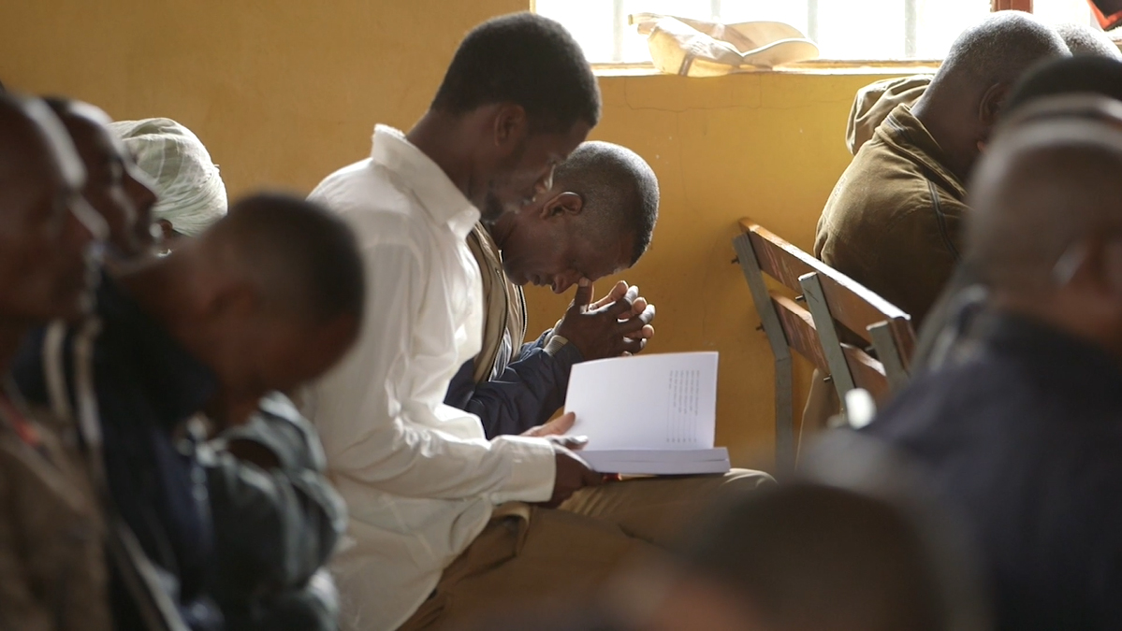
Statement of Faith

Slide 2
?
What do you think of when I say the word
“value”?
When we talk about “values,” we mean
the beliefs that define and guide the way we live.

Slide 3

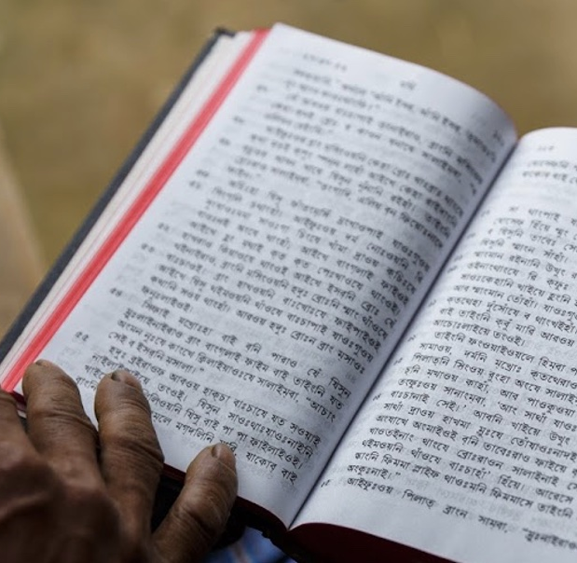
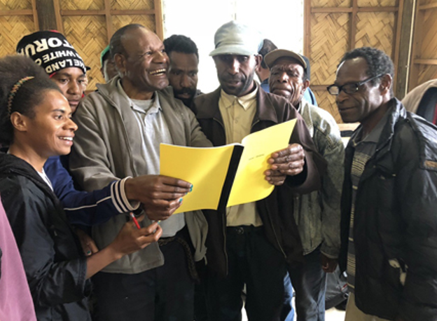
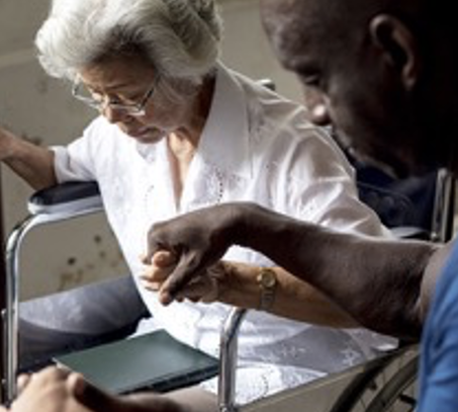
We believe that the Bible is the Word of God.
We believe that the Bible changes lives and advances God’s kingdom.
We believe in the power of the Holy Spirit in the lives of believers.

Slide 4
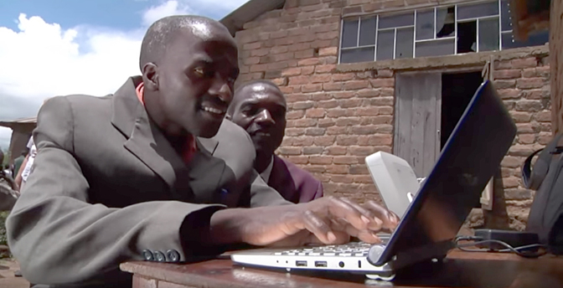
VISION:
A Bible in every language
MISSION:
Involving people
in the advancement of Bible translation

Slide 5
?
How does that vision and mission connect with our values?

Slide 6
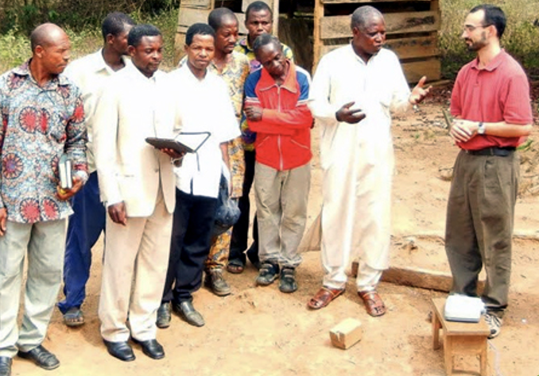
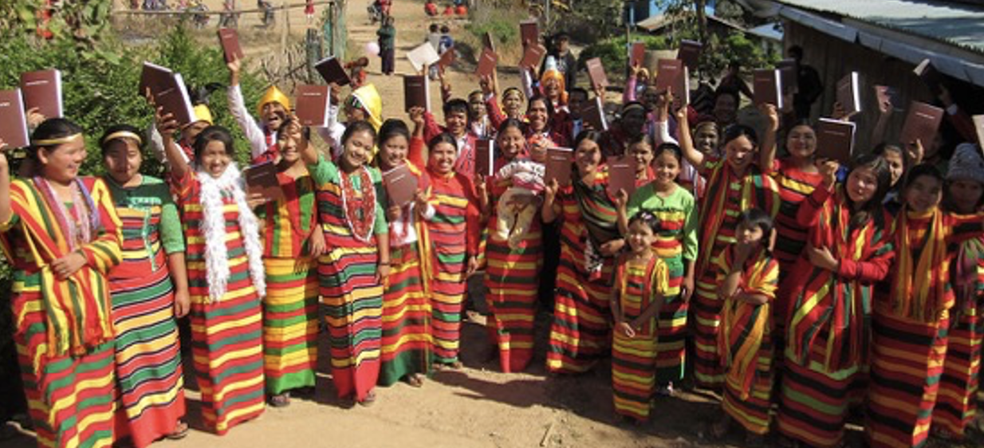
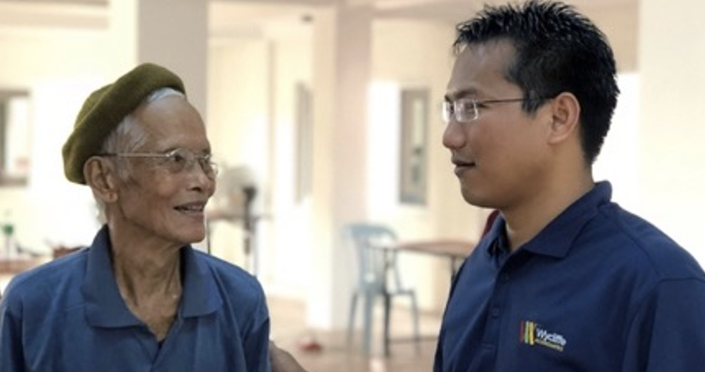
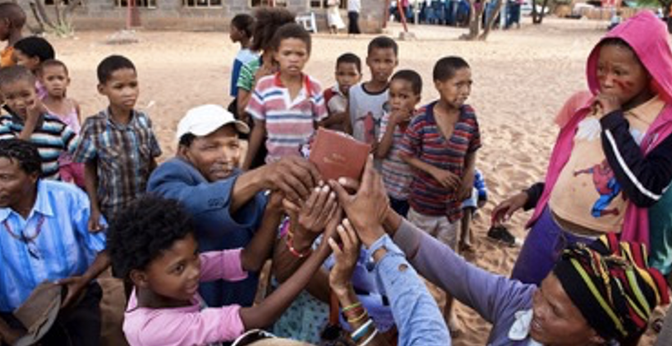
Every Language

Slide 7
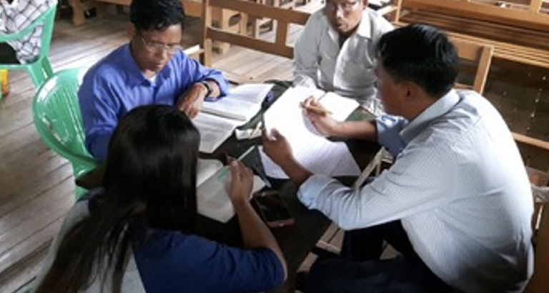
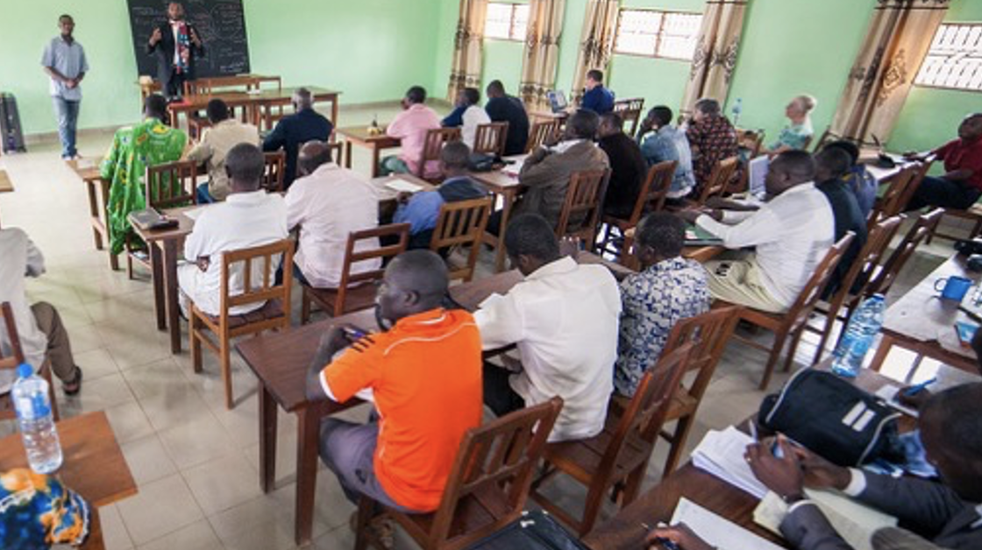
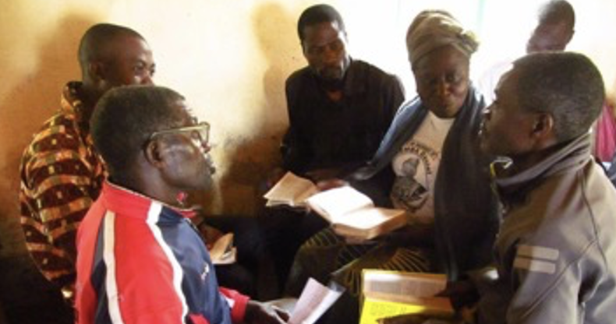
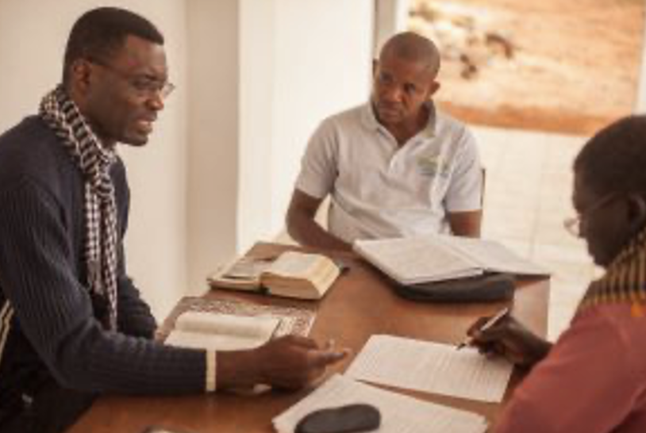
The whole Body of Christ

Slide 8


Core Beliefs
Statement of Faith

Slide 9
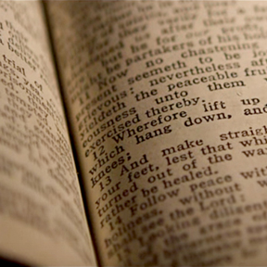
Statement of Faith
Primary Beliefs

Slide 10

Varied non-primary beliefs are OK
Example:
baptism by immersion or by sprinkling

Slide 11
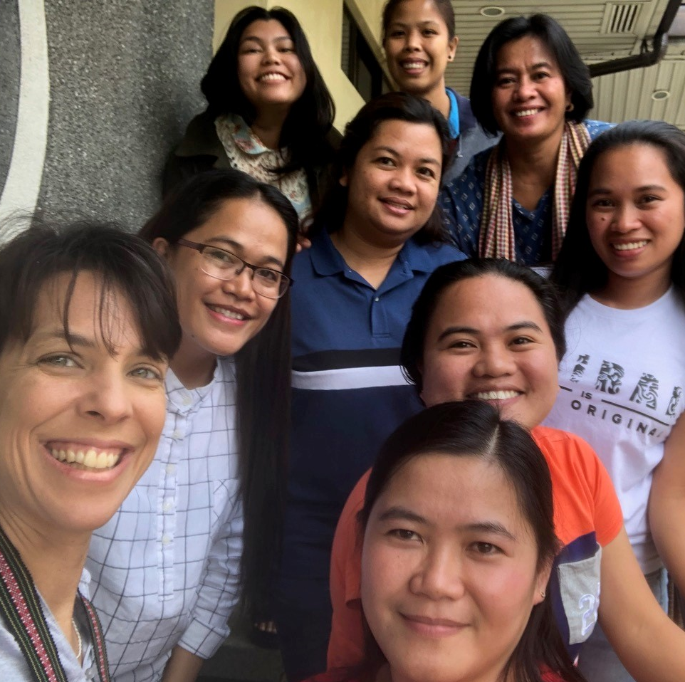
Statement of Faith
encourages:
unity
what is most important
a foundation for working together

Slide 12
We believe:
The Bible is divinely inspired by God and has final authority.
God is one and exists in three persons: God the Father, God the Son, and God the Holy Spirit.
Because of the fall of man, all humans are sinful and in need of salvation.
The death of Christ is a substitute for sinners and provides for the cleansing of those who believe.
By God’s grace, through faith, man receives salvation as a free gift because of Jesus’ death and resurrection.
There is a resurrection for all–the saved to eternal life and the lost to eternal punishment.

